Slide 1


Automating Student Management System with Stored Procedures
An SQL Automation Process…
Team A
SQL Intermediate

Slide 2

Why Automate?
Quickly Add Students
Streamline Enrollment
Efficiently insert new student records.
Seamlessly enroll students in courses.
Update Information
Automate student contact updates.

Slide 3
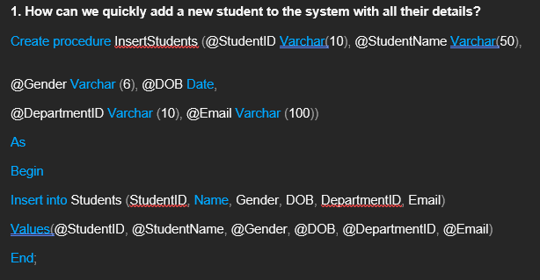
Insert Students Procedure
Adds new student records to the Students table.
Parameters:
@StudentID (string)
@StudentName (string)
@Gender (string)
@DOB (YYYY-MM-DD)
@DepartmentID (string)
@Email (string)

Slide 4
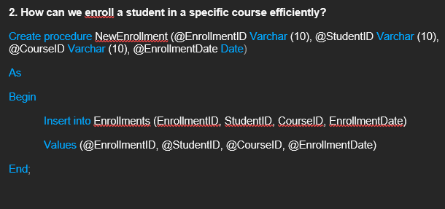
New Enrollment Procedure
Inserts new course enrollments into the Enrollments table.
Parameters:
@EnrollmentID
@StudentID
@CourseID
@EnrollmentDate

Slide 5
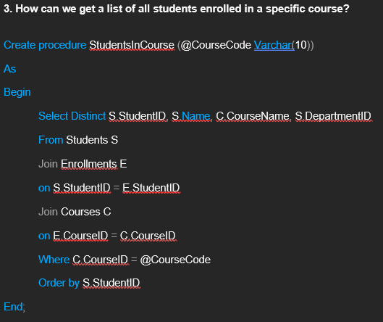
Students In Course Procedure
Returns a list of students enrolled in a specific course.
Parameter:
@CourseCode (e.g., 'PSY351')
Output:
StudentID, Name, CourseName, DepartmentID

Slide 6
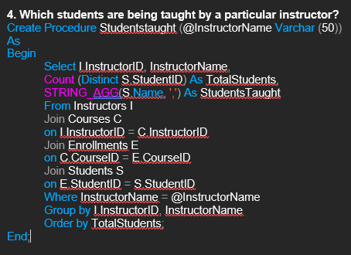
Students Taught Procedure
Lists students grouped by their instructor.
Parameter:
@InstructorName (e.g., 'Professor Bankole')
Output:
InstructorID, InstructorName, TotalStudents, StudentsTaught

Slide 7
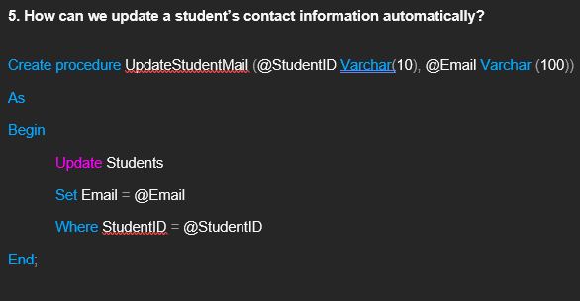
Update Student Mail Procedure
Updates student email addresses.
Parameters:
@StudentID
@Email

Slide 8
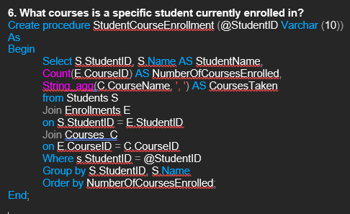
Student Course Enrollment Procedure
Lists all courses a specific student is enrolled in.
Parameter:
@StudentID
Output:
Student Name, NumberOfCoursesEnrolled, Courses Taken

Slide 9
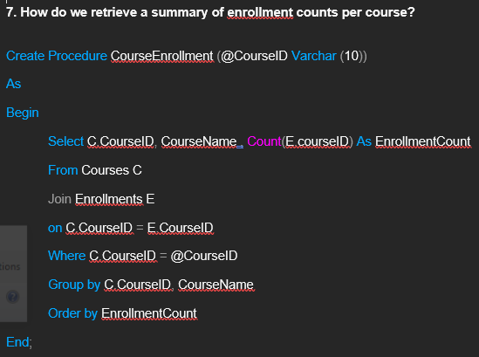
Course Enrollment Procedure
Shows the count of students enrolled in a specific course.
Parameter:
@CourseID
Output:
CourseID, CourseName, EnrollmentCount

Slide 10
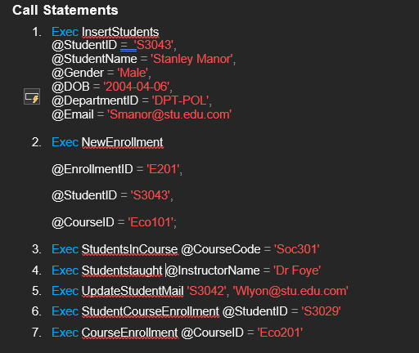
Call Statements

Slide 11
Conclusion
Conclusively, the automation of analytic queries through SQL stored procedures significantly
streamlines data processing, enhances query efficiency, and minimizes the risk of manual errors.
By embedding logic and reusability into stored procedures, organizations can achieve faster
insights, maintain consistency in reporting, and ensure scalability in handling large datasets.
This project underscores the value of stored procedures as a powerful tool in modern data analytics
Workflows, laying the groundwork for more robust and automated decision-making systems.
Through the aforementioned, it is not only important, but also pertinent for any business to
make use of automation in their day-to-day activity.
Thank You…

